Slide 1
Democracy In Bangladesh

Slide 2

Democracy
Democracy is a form of government in which the people have the authority to choose their governing legislation

Slide 3

Meaning and Concept Of Democracy
The ancient Greeks were the first to create a democracy. The word “democracy” comes from two Greek words that mean people ( demos) and rule ( kratos ).

Slide 4
Types Of Democracy
1.Direct Democracy
2. Representative Democracy

Slide 5
Principles Of Democracy
Liberty
Equality
Fraternity
Fundamental rights to the people
Independence of judiciary
Fair election

Slide 6
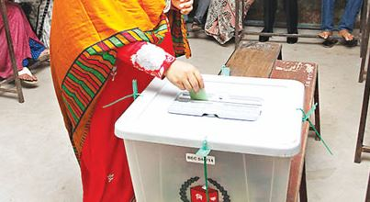
Democracy of Bangladesh
Bangladesh achieved sovereignty from Pakistan in 1971, a country established with a democratic framework. As a result, Bangladesh was also established with democratic institutions at its core.

Slide 7
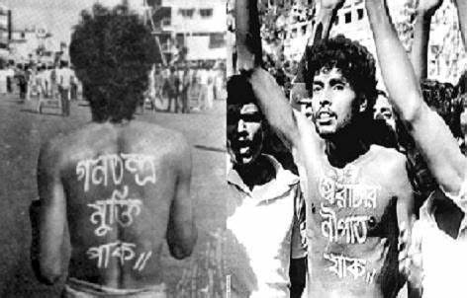
The History Of Democracy In Bangladesh
Democracy in Bangladesh was first introduced when the British ruled South Asia from 1700 to 1947, where Bangladesh was among the first British colonies in the subcontinent

Slide 8

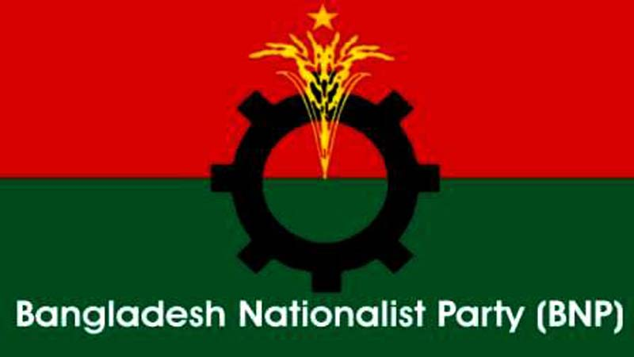
Democracy Overview In Bangladesh
Since From 1947 the Democracy of Bangladesh has changed a lot. The country was born out of long democratic movement initially aimed at achieving autonomy for the rights of majority population.
There are many political parties in Bangladesh. Like Awami league , BNP, Jatiyo Party etc

Slide 9
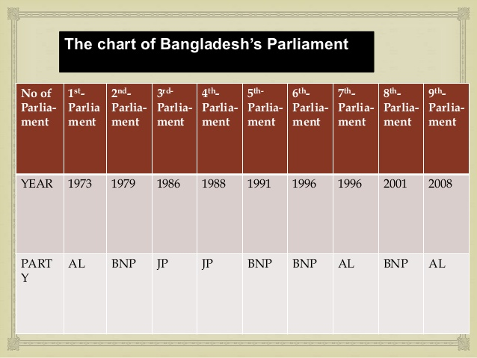
The Chart Of Bangladesh’s Parliament

Slide 10
Crisis Of Democracy In Bangladesh
Absence of democratic political culture.
Absence the rule of law.
Absence of strong political leadership.
Corruption
Lack of political morality
Weak Parliamentary Committee System
Problems of political parties
Problems of press media

Slide 11
Possible Solution To Improve The Situation :
Cautiousness of citizens
Free , fair and participatory election
Reform of political and social institution
Ensure equal distribution of wealth
Strong rule of law
Strong leadership
Spread the value of morality
Strong press and media

Slide 12
Prospects Of Democracy In Bangladesh
Provision for Caretaker Government
People’s Eagerness for Democracy
Peaceful Transition of Power
Response of Civil Society
Independence of Press, Media and Newspaper
Role of NGO
Women Empowerment

Slide 13
Conclusion
Though Bangladesh has facing various problems to institutionalize democracy but the suggested policy measures that was discussed can improve the situation and there are many prospects for Bangladesh.

Slide 14


